Slide 1
Table of Contents
This slide deck consists of slides used in 7 lecture videos in Week 2. Below is a list of shortcut hyperlinks for you to jump into specific sections.
(page 2) Week 2: URL Routing in Django
(page 9) Week 2:Django Views
(page 16) Week 2: Inside Django Views and HTML Escaping in Django
(page 28) Week 2: Using Templates in Django
(page 39) Week 2: The Django Template Language (DTL)
(page 47) Week 2: Inheritance in Django Templates
(page 53) Week 2: Reversing Django Views and URLs

Slide 2

Views and Templates
Charles Severance
www.dj4e.com
Notes:
Note from Chuck. If you are using these materials, you can remove my name and URL from this replace it with your own, but please retain the CC-BY logo on the first page as well as retain the entire last page when you remix and republish these slides.
TO Highlight – go to https://tohtml.com/html/ - paste and then do a "Paste RTF"

Slide 3
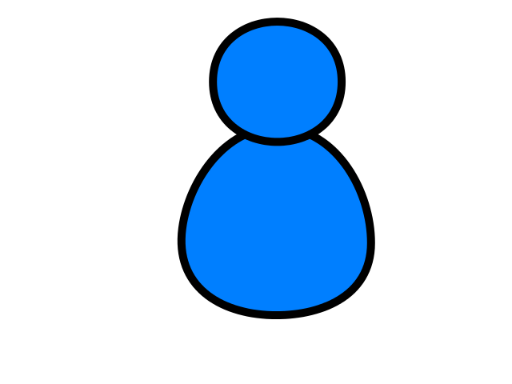
A diagram
Browser
Linux
D
O
M
N
G
I
N X
WGSIConfig
settings.py
Django
Routing
Click
urls.py
views.py
Parse
Response
Views
Templates
forms.py
Javascript
Database
Shell
Models
models.py
/admin
admin.py

Slide 4
Views are the core of our application
Django looks at the incoming request URL and uses urls.py to select a view
The view from views.py
Handle any incoming data in the request and copy it to the database through the model
Retrieve data to put on the page from the database though the model
Produce the HTML that will become the response and return it to the browser
https://samples.dj4e.com/

Slide 5
Reading the URL
When Django receives an HTTP request it parses it, uses some of the URL for routing purposes and passes parts of the URL to your code
Django Application (also folder)
View within application
https://samples.dj4e.com/views/funky
https://samples.dj4e.com/views/danger?guess=42
https://samples.dj4e.com/views/rest/24
Key / value parameter (GET)
URL Path Parameter

Slide 6
URL Dispatcher
A clean, elegant URL scheme is an important detail in a high-quality Web application. Django lets you design URLs however you want, with no framework limitations.
To design URLs for an app, you create a Python module informally called a URLconf (URL configuration). This module is pure Python code and is a mapping between URL path expressions to Python functions (your views).
This mapping can be as short or as long as needed. It can reference other mappings. And, because it’s pure Python code, it can be constructed dynamically.
https://docs.djangoproject.com/en/3.0/topics/http/urls/

Slide 7
Three patterns for views (in urls.py)
Requests are routed to a pre-defined class from Django itself
Requests are routed to a function in views.py that takes the http request as a parameter and returns a response
Requests are routed to a class in views.py that has get() and post() methods that take the http request as a parameter and return a response

Slide 8
Views
from django.urls import path
from . import views
from django.views.generic import TemplateView
# https://docs.djangoproject.com/en/3.0/topics/http/urls/
app_name='views'
urlpatterns = [
# pre-defined class from Django
path('', TemplateView.as_view(template_name='views/main.html')),
# function from views.py
path('funky', views.funky),
path('danger', views.danger),
path('game', views.game),
path('rest/<int:guess>', views.rest),
path('bounce', views.bounce),
# our class from views.py
path('main', views.MainView.as_view()),
path('remain/<slug:guess>', views.RestMainView.as_view()),
]
views/urls.py

Slide 9
Viewing the Views

Slide 10
Views
path('', TemplateView.as_view(template_name='views/main.html'))
views/urls.py
views/templates/views/main.html
<html><body><p>This is the views main.html sample</p>
<p>
<ul>
<li>This page is coming from a file in views/templates/main.html</li>
<li><a href="funky">Use a view function</a></li>
...
</ul>
</p>
<p>This sample code is available at
<a href="https://github.com/csev/dj4e-samples" target="_blank">
https://github.com/csev/dj4e-samples</a>
</p>
</body></html>

Slide 11
Request and Response Objects
Django uses request and response objects to pass information throughout your Django application.
When a page is requested by a browser, Django creates an HttpRequest object that contains metadata about the request.
Then Django loads the appropriate view, passing the HttpRequest as the first argument to the view function. Each view is responsible for returning an HttpResponse object.
The Application Programming Interfaces (APIs) for HttpRequest and HttpResponse objects, are defined in the django.http module.
https://docs.djangoproject.com/en/3.0/ref/request-response/

Slide 12
class HttpRequest
Attributes
All attributes should be considered read-only, unless stated otherwise.
HttpRequest.scheme
A string representing the scheme of the request (http or https usually).
HttpRequest.body
The raw HTTP request body as a bytestring. This is useful for processing data in different ways than conventional HTML forms: binary images, XML payload etc. For processing conventional form data, use HttpRequest.POST.
https://docs.djangoproject.com/en/3.0/ref/request-response/#django.http.HttpRequest

Slide 13
class HttpResponse
In contrast to HttpRequest objects, which are created automatically by Django, HttpResponse objects are your responsibility.
Each view you write is responsible for instantiating, populating, and returning an HttpResponse.
Passing strings
Typical usage is to pass the contents of the page, as a string or bytestring, to the HttpResponse constructor.
https://docs.djangoproject.com/en/3.0/ref/request-response/#django.http.HttpResponse

Slide 14
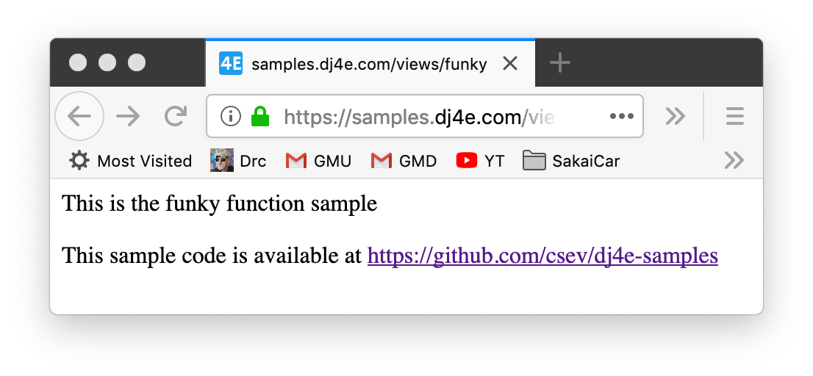
Views
https://samples.dj4e.com/views/funky
path('funky', views.funky),
from django.http import HttpResponse
from django.http import HttpResponseRedirect
# Create your views here.
def funky(request):
response = """<html><body><p>This is the funky function sample</p>
<p>This sample code is available at
<a href="https://github.com/csev/dj4e-samples">
https://github.com/csev/dj4e-samples</a></p>
</body></html>"""
return HttpResponse(response)

Slide 15
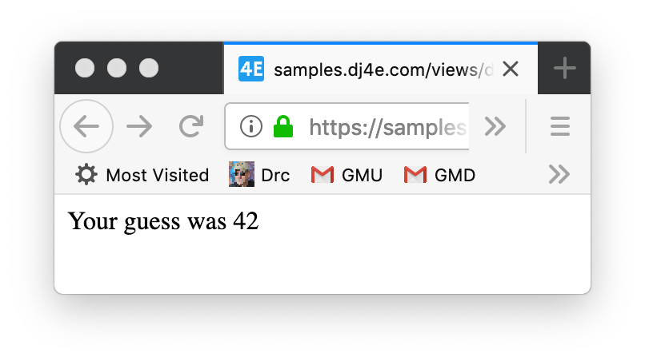
Views
https://samples.dj4e.com/views/danger?guess=42
path('danger', views.danger),
views/urls.py
from django.http import HttpResponse
from django.http import HttpResponseRedirect
# Create your views here.
def danger(request) :
response = """<html><body>
<p>Your guess was """+request.GET['guess']+"""</p>
</body></html>"""
return HttpResponse(response)
views/views.py

Slide 16
Danger – What Danger?
I use the django.http.escape() function whenever I sense danger…

Slide 17
Why is that view named danger?
It is dangerous to take data from the user and include it in the HTTP Response without "escaping" the output.
HTML + JavaScript is a programming language and you don't want your users "sending code" to other user's browsers
Cross-Site Scripting (XSS)
https://en.wikipedia.org/wiki/Cross-site_scripting
https://en.wikipedia.org/wiki/List_of_XML_and_HTML_character_entity_references

Slide 18
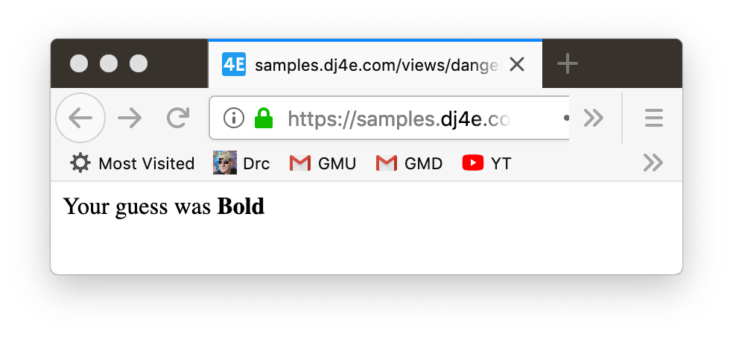
Danger
https://samples.dj4e.com/views/danger?guess=%3Cb%3EBold%3C%2Fb%3E
def danger(request) :
response = """<html><body>
<p>Your guess was """+request.GET['guess']+"""</p>
</body></html>"""
return HttpResponse(response)
Response Source
<html><body>
<p>Your guess was <b>Bold</b></p>
</body></html>

Slide 19
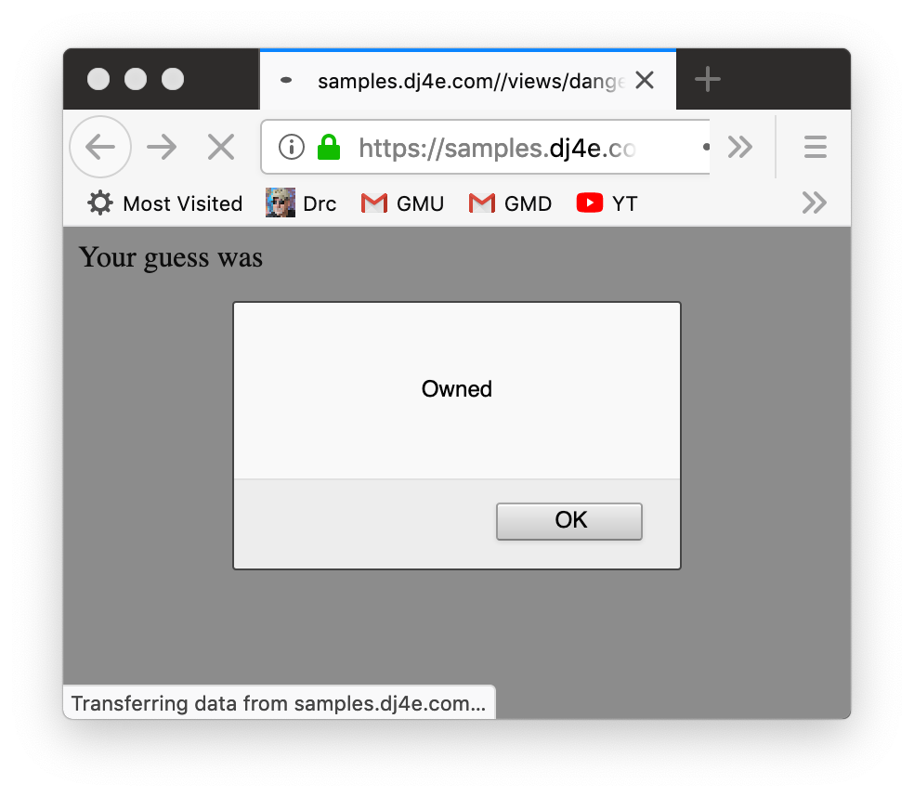
Danger
https://samples.dj4e.com/views/danger?guess=%3Cscript%3Ealert%28%27Owned%27%29%3B%3C%2Fscript%3E
Response Source
<html><body>
<p>Your guess was <script>alert('Owned');</script></p>
</body></html>

Slide 20
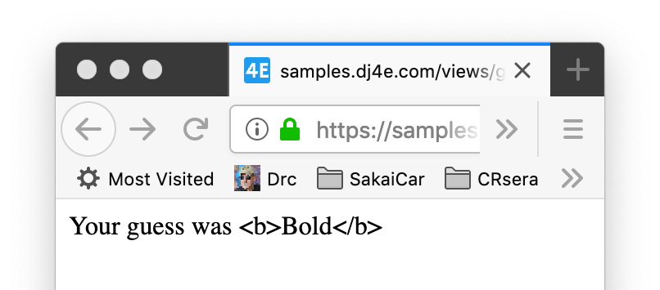
HTML entities
https://samples.dj4e.com/views/game?guess=%3Cb%3EBold%3C%2Fb%3E
from django.utils.html import escape
def game(request) :
response = """<html><body>
<p>Your guess was """+escape(request.GET['guess'])+"""</p>
</body></html>"""
return HttpResponse(response)
<html><body>
<p>Your guess was &lt;b&gt;Bold&lt;/b&gt;</p>
</body></html>

Slide 21
Parsing the URL after the Application and View
https://samples.dj4e.com/views/rest/41
urlpatterns = [
path('rest/<int:guess>', views.rest),
]
<type:parameter-name>
from django.http import HttpResponse
from django.utils.html import escape
def rest(request, guess) :
response = """<html><body>
<p>Your guess was """+escape(guess)+"""</p>
</body></html>"""
return HttpResponse(response)

Slide 22
Class Views – Inheritance
path('main', views.MainView.as_view()),
from django.http import HttpResponse
from django.utils.html import escape
from django.views import View
class MainView(View) :
def get(self, request):
response = """<html><body><p>Hello world MainView in HTML</p>
<p>This sample code is available at
<a href="https://github.com/csev/dj4e-samples">
https://github.com/csev/dj4e-samples</a></p>
</body></html>"""
return HttpResponse(response)
https://www.py4e.com/lessons/Objects

Slide 23
Parameters to Class Views
https://samples.dj4e.com/views/remain/abc123-42-xyzzy
path('remain/<slug:guess>', views.RestMainView.as_view()),
from django.http import HttpResponse
from django.utils.html import escape
from django.views import View
class RestMainView(View) :
def get(self, request, guess):
response = """<html><body>
<p>Your guess was """+escape(guess)+"""</p>
</body></html>"""
return HttpResponse(response)
https://www.py4e.com/lessons/Objects

Slide 24
HTTP Status Codes
http://www.dr-chuck.com/page1.htm - 200 OK
http://www.dj4e.com/nowhere.htm - 404 Not Found
500 Server Error
http://www.drchuck.com/ - 302 Found / Moved
Also known as “redirect”
https://en.wikipedia.org/wiki/List_of_HTTP_status_codes

Slide 25
HTTP Location Header
You can send a "Redirect" response instead of a page response to communicate a "Location:" header to the browser
The location header includes a URL that the browser is supposed to forward itself to.
It was originally used for web sites that moved from one URL to another.
http://en.wikipedia.org/wiki/URL_redirection

Slide 26
Sending a Redirect from a View
https://samples.dj4e.com/views/bounce
path('bounce', views.bounce)
from django.http import HttpResponse
from django.http import HttpResponseRedirect
# This is a command to the browser
def bounce(request) :
return HttpResponseRedirect('https://www.dj4e.com/simple.htm')
https://docs.djangoproject.com/en/3.0/ref/request-response/#django.http.HttpResponseRedirect

Slide 27
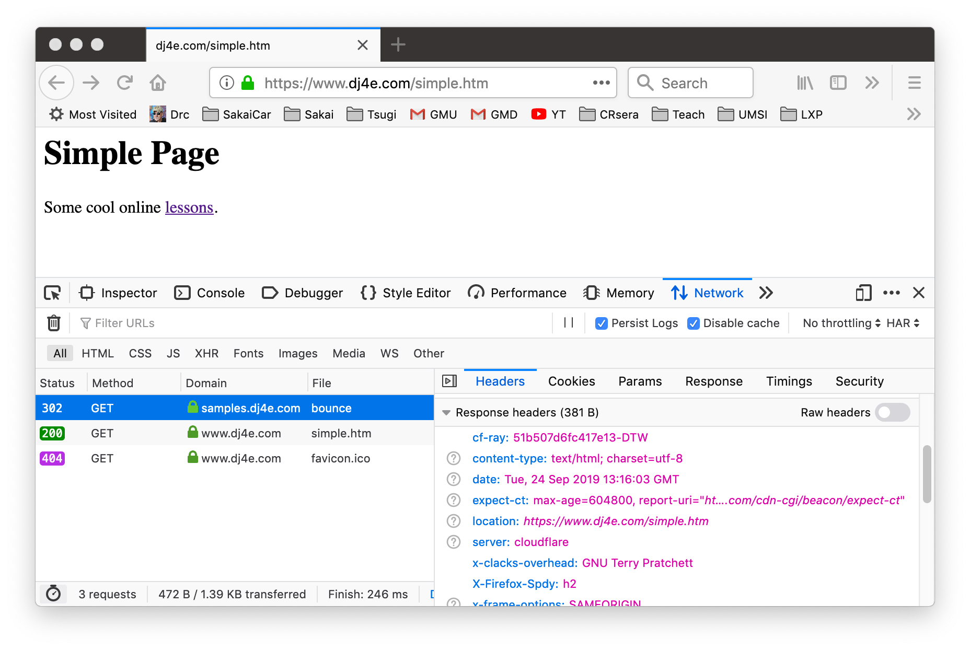
Templates

Slide 28
Templates to Organize HTML
https://github.com/csev/dj4e-samples/tree/master/tmpl

Slide 29
A diagram
Browser
Linux
D
O
M
N
G
I
N X
WGSIConfig
settings.py
Django
Routing
Click
urls.py
views.py
Parse
Response
Views
Templates
forms.py
Javascript
Database
Shell
Models
models.py
/admin
admin.py

Slide 30
Templates
Being a web framework, Django needs a convenient way to generate HTML dynamically. The most common approach relies on templates. A template contains the static parts of the desired HTML output as well as some special syntax describing how dynamic content will be inserted.
A Django project can be configured with one or several template engines (or even zero if you don’t use templates). Django ships built-in backends for its own template system, creatively called the Django template language (DTL), and for the popular alternative Jinja2.
A template is simply a text file. It can generate any text-based format (HTML, XML, CSV, etc.). A template contains variables, which get replaced with values when the template is evaluated, and tags, which control the logic of the template.
https://docs.djangoproject.com/en/3.0/topics/templates/

Slide 31
What is a Template?
Concatenation and escaping can get tiresome and lead to very obtuse looking view code.
from django.http import HttpResponse
from django.utils.html import escape
from django.views import View
class RestMainView(View) :
def get(self, request, guess):
response = """<html><body>
<p>Your guess was """+escape(guess)+"""</p>
</body></html>"""
return HttpResponse(response)
https://samples.dj4e.com/views/rest/24

Slide 32
Template Render Process
Render Data
Template
Render
Engine
Rendered
Output

Slide 33
Template Render Process
<h1>Hi!</h1>
<pre>
{{ dat }}
</pre>
{ 'dat' : 'Fun > Stuff' }
Render
Engine
<h1>Hi!</h1>
<pre>
Fun &gt; Stuff
</pre>

Slide 34
URL -> View -> Template
https://samples.dj4e.com/tmpl/game/200
path('game/<slug:guess>', views.GameView.as_view())
from django.shortcuts import render
from django.views import View
class GameView(View) :
def get(self, request, guess) :
x = {'guess' : int(guess) }
return render(request, 'tmpl/cond.html', x)

Slide 35
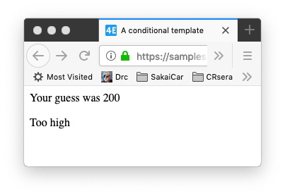
Template
https://samples.dj4e.com/tmpl/game/200
from django.views import View
class GameView(View) :
def get(self, request, guess) :
x = {'guess' : int(guess) }
return render(request, 'tmpl/cond.html', x)
dj4e-samples/tmpl/templates/tmpl/cond.html
<html>
<head>
<title>A conditional template</title>
</head>
<body>
<p>Your guess was {{ guess }}</p>
{% if guess < 42 %}
<p>Too low</p>
{% elif guess > 42 %}
<p>Too high</p>
{% else %}
<p>Just right</p>
{% endif %}
</body>
</html>

Slide 36
Where are Templates?
A Django project is made up of one or more applications in folders
dj4e-samples$ ls
LICENSE.md form pics
README.md forums requirements.txt
autos getpost rest
bookmany gview route
bookone hello scripts
crispy home session
db.sqlite3 manage.py tmpl
dj4e-samples many tracks
favs menu users
favsql myarts views

Slide 37
Templates in Folders
It is common to reuse the "name" of a template file in several applications
We use a technique called "namespace" so that each application can load its own templates without template name collision
dj4e-samples$ ls */templates/*/detail.html favs/templates/favs/detail.html
favsql/templates/favsql/detail.html
forums/templates/forums/detail.html
pics/templates/pics/detail.html
dj4e-samples$
https://en.wikipedia.org/wiki/Namespace
https://docs.djangoproject.com/en/3.0/topics/http/urls/#url-namespaces

Slide 38
Templates in Name Spaces
For the namespace to work, we need to put templates in a path that includes the application name twice. Weird but necessary. ☹
dj4e-samples$ ls */templates/*/detail.html favs/templates/favs/detail.html
favsql/templates/favsql/detail.html
forums/templates/forums/detail.html
pics/templates/pics/detail.html
dj4e-samples$
https://en.wikipedia.org/wiki/Namespace
https://docs.djangoproject.com/en/3.0/topics/http/urls/#url-namespaces

Slide 39
Django template language (DTL)
https://docs.djangoproject.com/en/3.0/ref/templates/language/

Slide 40
Template Tags / Code
{{ zap }}
{{ zap|safe }}
{% url 'cat-detail' cat.id %}
{% author.get_absolute_url %}
{% if zap > 100 %}
{% endif %}
{% block content %}
{% endblock %}
Substitution
Calling code
Logic
Blocks

Slide 41
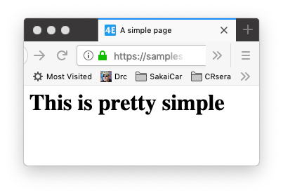
Template
https://samples.dj4e.com/tmpl/simple
from django.shortcuts import render
def simple(request):
return render(request, 'tmpl/simple.html')
dj4e-samples/tmpl/templates/tmpl/simple.html
<html>
<head>
<title>A simple page</title>
</head>
<body>
<h1>This is pretty simple</h1>
</body>
</html>

Slide 42
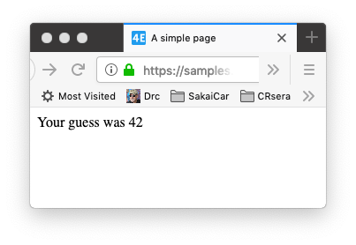
Template
https://samples.dj4e.com/tmpl/guess
def guess(request) :
context = {'zap' : '42' }
return render(request, 'tmpl/guess.html', context)
dj4e-samples/tmpl/templates/tmpl/guess.html
<html>
<head>
<title>A simple page</title>
</head>
<body>
<p>Your guess was {{ zap }}</p>
</body>
</html>

Slide 43
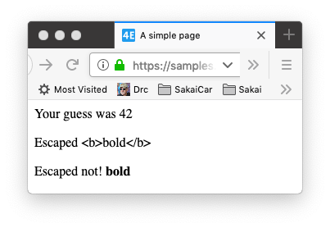
Template
https://samples.dj4e.com/tmpl/special
def special(request) :
context = {'txt' : '<b>bold</b>',
'zap' : '42' }
return render(request, 'tmpl/special.html', context)
dj4e-samples/tmpl/templates/tmpl/special.html
<body>
<p>Your guess was {{ zap }}</p>
<p>Escaped {{ txt }}</p>
<p>Escaped not! {{ txt|safe }}</p>
</body>

Slide 44
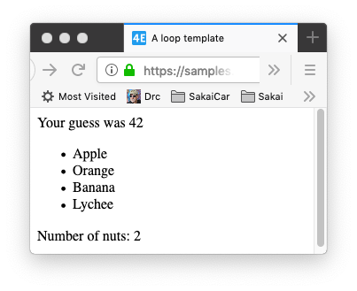
Template
https://samples.dj4e.com/tmpl/loop
def loop(request) :
f = ['Apple', 'Orange', 'Banana', 'Lychee']
n = ['peanut', 'cashew']
x = {'fruits' : f, 'nuts' : n, 'zap' : '42' }
return render(request, 'tmpl/loop.html', x)
dj4e-samples/tmpl/templates/tmpl/loop.html
<ul>
{% for x in fruits %}
<li>{{ x }}</li>
{% endfor %}
</ul>
{% if nuts %}
<p>Number of nuts: {{ nuts|length }}</p>
{% else %}
<p>No nuts.</p>
{% endif %}

Slide 45
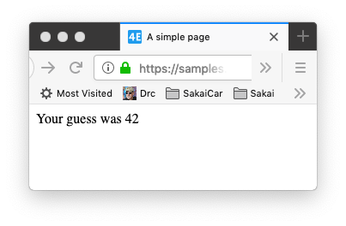
Template
https://samples.dj4e.com/tmpl/nested
def nested(request) :
x = {'outer' : { 'inner' : '42' } }
return render(request, 'tmpl/nested.html', x)
dj4e-samples/tmpl/templates/tmpl/nested.html
<body>
<p>Your guess was {{ outer.inner }}</p>
</body>

Slide 46
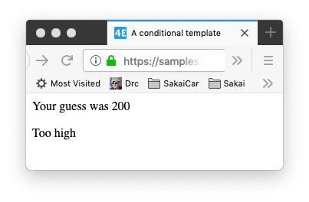
Template
https://samples.dj4e.com/tmpl/game/200
path('game/<slug:guess>', views.GameView.as_view())
class GameView(View) :
def get(self, request, guess) :
x = {'guess' : int(guess) }
return render(request, 'tmpl/cond.html', x)
dj4e-samples/tmpl/templates/tmpl/cond.html
<p>Your guess was {{ guess }}</p>
{% if guess < 42 %}
<p>Too low</p>
{% elif guess > 42 %}
<p>Too high</p>
{% else %}
<p>Just right</p>
{% endif %}

Slide 47
Template Inheritance
https://docs.djangoproject.com/en/3.0/ref/urlresolvers/

Slide 48
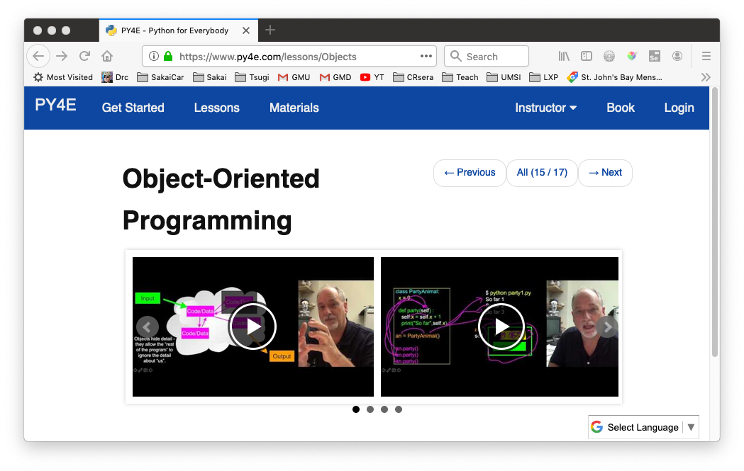
Review Python Object-Oriented Programming
https://www.py4e.com/lessons/Objects

Slide 49
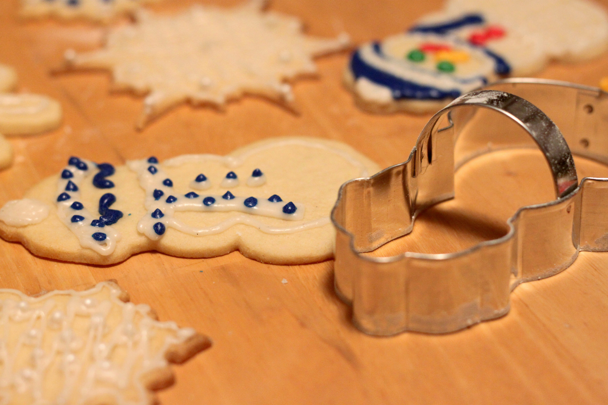
Inheritance
When we make a new template - we can extend an existing template and then add our own little bit to make our new class
Another form of store and reuse
Don't Repeat Yourself (DRY)
https://en.wikipedia.org/wiki/Don%27t_repeat_yourself

Slide 50
Template Inheritance
Base
Template
Render
Data
Template
Render
Engine
Rendered
Output

Slide 51
Template Inheritance
tmpl/templates/tmpl/base.html
<html>
<head>
<title>Base template</title>
</head>
<body>
{% block content %}{% endblock %}
</body>
</html>
tmpl/templates/tmpl/cond.html
<html>
<head>
<title>A conditional template</title>
</head>
<body>
<p>Your guess was {{ guess }}</p>
{% if guess < 42 %}
<p>Too low</p>
{% elif guess > 42 %}
<p>Too high</p>
{% else %}
<p>Just right</p>
{% endif %}
</body>
</html>
tmpl/templates/tmpl/cond2.html
{% extends "tmpl/base.html" %}
{% block content %}
<p>Your guess was {{ guess }}</p>
{% if guess < 42 %}
<p>Too low</p>
{% elif guess > 42 %}
<p>Too high</p>
{% else %}
<p>Just right</p>
{% endif %}
{% endblock %}

Slide 52
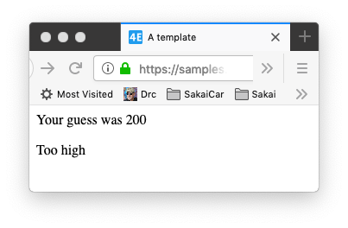
Template Inheritance
https://samples.dj4e.com/tmpl/game2/200
class GameView2(View) :
def get(self, request, guess) :
x = {'guess' : int(guess) }
return render(request, 'tmpl/cond2.html', x)
tmpl/templates/tmpl/cond2.html
tmpl/templates/tmpl/base.html
{% extends "tmpl/base.html" %}
{% block content %}
<p>Your guess was {{ guess }}</p>
{% if guess < 42 %}
<p>Too low</p>
{% elif guess > 42 %}
<p>Too high</p>
{% else %}
<p>Just right</p>
{% endif %}
{% endblock %}
<html>
<head>
<title>A template</title>
</head>
<body>
{% block content %}{% endblock %}
</body>
</html>

Slide 53
URL Mapping / Reversing
https://samples.dj4e.com/route/
https://docs.djangoproject.com/en/3.0/topics/http/urls/#reverse-resolution-of-urls

Slide 54
A diagram
Browser
Linux
D
O
M
N
G
I
N X
WGSIConfig
settings.py
Django
Routing
Click
urls.py
views.py
Parse
Response
Views
Templates
forms.py
Javascript
Database
Shell
Models
models.py
/admin
admin.py

Slide 55
Reverse Resolution of URLs
A common need when working on a Django project is the possibility to obtain URLs in their final forms either for embedding in generated content or for handling of the navigation flow on the server side (redirections, etc.)
It is strongly desirable to avoid hard-coding these URLs . Equally dangerous is devising ad-hoc mechanisms to generate URLs that are parallel to the design described by the URLconf, which can result in the production of URLs that become stale over time.
In other words, what’s needed is a DRY mechanism. Among other advantages it would allow evolution of the URL design without having to go over all the project source code to search and replace outdated URLs.
The primary piece of information we have available to get a URL is an identification (e.g. the name) of the view in charge of handling it. Other pieces of information that necessarily must participate in the lookup of the right URL are the types (positional, keyword) and values of the view arguments.
https://docs.djangoproject.com/en/3.0/topics/http/urls/#reverse-resolution-of-urls

Slide 56
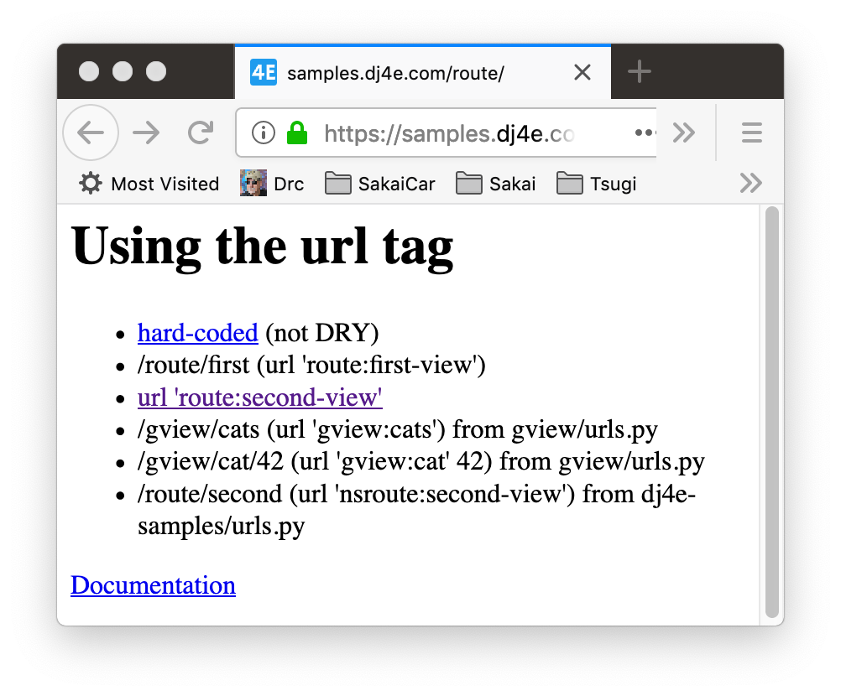
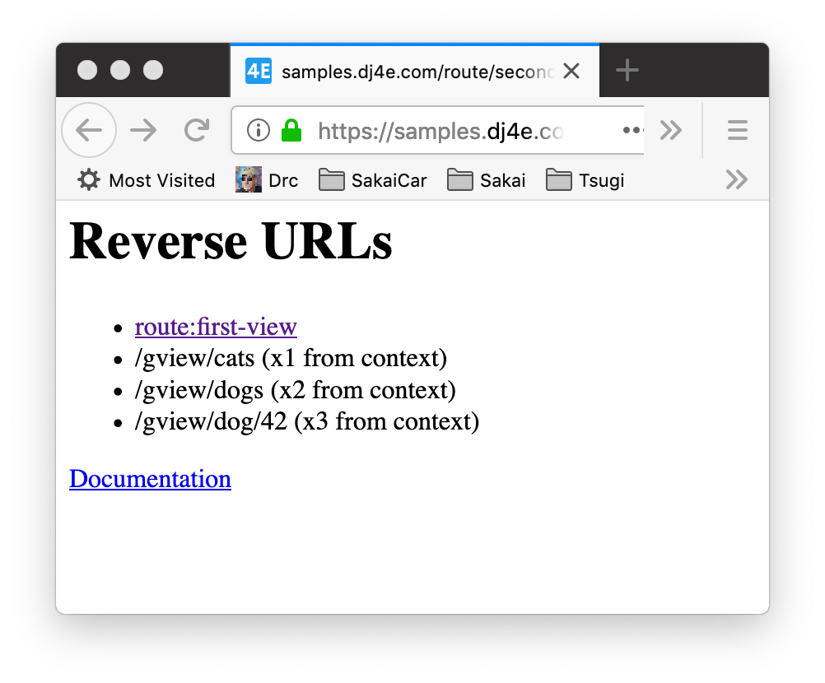
URLs
dj4e-samples/route/urls.py
urlpatterns = [
path('', TemplateView.as_view(template_name='route/main.html')),
path('first', views.FirstView.as_view(), name='first-view'),
path('second', views.SecondView.as_view(), name='second-view'),
]
https://samples.dj4e.com/route/
https://samples.dj4e.com/route/second

Slide 57
Using the url tag in a template
app_name = 'route'
urlpatterns = [
path('', TemplateView.as_view(template_name='route/main.html')),
path('first', views.FirstView.as_view(), name='first-view'),
path('second', views.SecondView.as_view(), name='second-view'),
]
dj4e-samples/route/urls.py
dj4e-samples/route/templates/route/main.html
<li>
<a href="/route/second">
hard-coded</a> (not DRY)
</li>
<li>
{% url 'route:first-view' %}
(url 'route:first-view')
</li>
<li>
<a href="{% url 'route:second-view' %}">
url 'route:second-view'</a>
</li>
route:first-view
application
name
view
name

Slide 58
URLs
https://samples.dj4e.com/route/
dj4e-samples/route/templates/route/main.html
<li>
<a href="/route/second-view">
hard-coded</a> (not DRY)
</li>
<li>
{% url 'route:first-view' %}
(url 'route:first-view')
</li>
<li>
<a href="{% url 'route:second-view' %}">
url 'route:second-view'</a>
</li>

Slide 59
Other applications and parameters
dj4e-samples/gview/urls.py
app_name = 'gview'
urlpatterns = [
path('cats', views.CatListView.as_view(), name='cats'),
path('cat/<int:pk_from_url>', views.CatDetailView.as_view(), name='cat'),
]
dj4e-samples/route/templates/route/main.html
Parameter
'gview:cat' 42
<li>
{% url 'gview:cats' %}
(url 'gview:cats') from gview/urls.py
</li>
<li>
{% url 'gview:cat' 42 %}
(url 'gview:cat' 42) from gview/urls.py
</li>
application
name
view
name

Slide 60
URLs
https://samples.dj4e.com/route/
dj4e-samples/route/templates/route/main.html
<li>
{% url 'gview:cats' %}
(url 'gview:cats')
</li>
<li>
{% url 'gview:cat' 42 %}
(url 'gview:cat' 42)
</li>

Slide 61
A "second" name space
dj4e-samples/dj4e-samples/urls.py
urlpatterns = [
path('', include('home.urls')),
path('admin/', admin.site.urls), # Keep
url(r'^oauth/', include('social_django.urls', namespace='social')),
path('hello/', include('hello.urls')),
path('route/', include('route.urls', namespace='nsroute')),
]
dj4e-samples/route/templates/route/main.html
<li>
<a href="{% url 'route:second-view' %}">
url 'route:second-view'</a>
</li>
. . .
<li>
{% url 'nsroute:second-view' %}
(url 'nsroute:second-view')
</li>

Slide 62
URLs
path('second', views.SecondView.as_view(), name='second-view'),
dj4e-samples/route/urls.py
dj4e-samples/route/views.py
dj4e-samples/route/templates/route/main.html
from django.shortcuts import render
from django.urls import reverse
from django.views import View
class SecondView(View):
def get(self, request) :
u = reverse('gview:cats')
u2 = reverse('gview:dogs')
u3 = reverse('gview:dog', args=['42'] )
ctx = {'x1' : u, 'x2': u2, 'x3': u3 }
return render(request, 'route/second.html', ctx)
<li>
<a href="{% url 'route:first-view' %}">
route:first-view</a>
</li>
<li>
{{ x1 }} (x1 from context)
</li>
<li>
{{ x2 }} (x2 from context)
</li>
<li>
{{ x3 }} (x3 from context)
</li>

Slide 63
URLs
dj4e-samples/route/templates/route/main.html
https://samples.dj4e.com/route/second
class SecondView(View):
def get(self, request) :
u = reverse('gview:cats')
u2 = reverse ('gview:dogs')
u3 = reverse('gview:dog', args=['42'] )
ctx = {'x1' : u, 'x2': u2, 'x3': u3 }
return render(request, 'route/second.html', ctx)
dj4e-samples/route/templates/route/main.html
<li>
{{ x1 }} (x1 from context)
</li>
<li>
{{ x2 }} (x2 from context)
</li>
<li>
{{ x3 }} (x3 from context)
</li>

Slide 64
Summary
Views are where we bring the application components together to handle requests from browsers and produce responses for the browsers
Templates take a context and merge it into a template to produce HTML
Values can be substituted without without "escaping"
Coding in templates

Slide 65
Acknowledgements / Contributions
These slides are Copyright 2019- Charles R. Severance (www.dr-chuck.com) as part of www.dj4e.com and made available under a Creative Commons Attribution 4.0 License. Please maintain this last slide in all copies of the document to comply with the attribution requirements of the license. If you make a change, feel free to add your name and organization to the list of contributors on this page as you republish the materials.
Initial Development: Charles Severance, University of Michigan School of Information
Insert new Contributors and Translators here including names and dates
Continue new Contributors and Translators here

Slide 66
Additional Source Information
Snowman Cookie Cutter" by Didriks is licensed under CC BY https://www.flickr.com/photos/dinnerseries/23570475099
Portions of the text of these slides is adapted from the text www.djangoproject.org web site. Those slides which use text from that site have a reference to the original text on that site. Django is licensed under the three-clause BSD license.

